Slide 1
Training on AVR Microcontroller for Automation in Power Sector
Module: M#4
Input / Output (continued)
Professor S.M. Lutful Kabir
IICT, BUET
March, 2018

Slide 2
LCD Display : Its advantages
LED consumes lot of power
Advantages of LCD
Low power consumption
Easy to read in bright light
Declining cost
Ability to display both Alphanumeric and Graphics
In different form, 7-segment & graphics form

Slide 3
7 Segment vs LCD (Class Note by Nasir)
7 Segment is best for Number only where as LCD can display character and graphics also.
LED Consumes more power than LCD
LCD declines cost than LED

Slide 4
Intelligent Controller and LCD Display Panel
An LCD panel and a small circuit board containing a controller chip
14 pin connection
2 rows, 20/40 characters in each row
Easy to program
Each character is displayed on a 5X8 or 5X11 dot matrix display
V_{ss}
V_{DD}
V₀
Line 1
Line 2
D_{o}
D₇
RS
R/W
E
Hitachi’s HD 44780 LCD module

Slide 5
LCD Display Panel (Class note by Nasir)
LCD panel has a small circuit board with an individual controller named as intelligent controller
A panel has 14 pins, 8(D0 to D7) pins for data, Vss for Ground, V0 or Vcc for Supply, Vdd for Contrast, RS low for command register high for data register, RW Low to write high to read, EN sends data to data port when a high to low pulse is given.
5v fixed supply in Vdd provide maximum contrast.
Two rows containing 20/40 characters in each row.
Each character displayed on a 5X8 or 5X11 dot matrix display.

Slide 6
8-bit Connection
+5V
PA.0
D₀
V_{CC}
LCD
10K pot
V_{EE}
PA.7
D₇
V_{SS}
Atmega32
GND
R/W
RS
E
PB.0
PB.1
PB.2

Slide 7
4-bit Connection
+5V
+5V
PA.4
D₄
V_{CC}
PA.4
D₄
V_{CC}
LCD
LCD
V_{EE}
V_{EE}
PA.7
D₇
V_{SS}
PA.7
D₇
V_{SS}
Atmega32
GND
Atmega32
GND
R/W
R/W
RS
E
RS
E
PA.0
PB.0
PA.1
PB.1
PA.2
PB.2
Data and Control from Different Ports
Data and Control from a single port

Slide 8
LCD Pin Description
LCD has 14 pins. The pin description is given below.
Pin | Symbol | I/O | Description
1 | V_{SS} | -- | Ground
2 | V_{DD} | -- | +5V
3 | V_{EE} | -- | +V to control contrast
4 | RS | I | 0=Command Reg, 1=Data Reg
5 | R/W | I | 1=Read, 0=Write
6 | E | I/O | Enable
7-14 | D0-D7 | I/O | 8-bit Data Pin

Slide 9
The Connection of Pins for LCD
The LCD module must be connected (for the demo board) to the port bits as follows:
[LCD] [AVR Port]
RS (pin4) ------ PA.0
RD (pin 5) ------ PA.1
EN (pin 6) ------ PA.2
DB4 (pin 11) --- PA.4
DB5 (pin 12) --- PA.5
DB6 (pin 13) --- PA.6
DB7 (pin 14) --- PA.7
You must also connect the LCD power supply and contrast control voltage, according to the data sheet.

Slide 10
Some of the functions used for LCD
unsigned char lcd_init(unsigned char lcd_columns)
initializes the LCD module, clears the display and sets the printing character position at row 0 and column 0. The numbers of columns of the LCD must be specified (e.g. 16). No cursor is displayed.
void lcd_clear(void)
clears the LCD and sets the printing character position at row 0 and column 0.
void lcd_gotoxy(unsigned char x, unsigned char y)
sets the current display position at column x and row y. The row and column numbering starts from 0.
void lcd_putsf(char flash *str)
displays at the current display position the string str, located in FLASH

Slide 11
unsigned char lcd_init(unsigned char lcd_columns)
Initialized the lcd
void lcd_clear(void)
Clears the lcd and sets the display position to 0,0
void lcd_gotoxy(unsigned char x, unsigned char y)
Sets the display position to x,y
void lcd_putsf(char flash *str)
Displays at the current display position the string str, located in FLASH

Slide 12
Main function
void main(void) {
lcd_init(16);
while (1) {
lcd_clear();
lcd_gotoxy(0,0);
lcd_putsf("AVR Devp. Board");
delay_ms(1000);
lcd_gotoxy(0,1);
lcd_putsf(“LCD Test Program");
delay_ms(2000);
lcd_clear();
lcd_gotoxy(0,0);
lcd_putsf("ATmega 32");
delay_ms(1000);
lcd_gotoxy(0,1);
lcd_putsf("Microcontroller");
delay_ms(2000);
}
}

Slide 13
DDRx Register Role in Inputting Data
To make a port an input port, we must first put 0s into the DDRx register for that port.
Then we can read the data which is residing at the pins of Port x.
Notice that upon reset, all ports have the value 0x00 in their DDRx registers.
That is all ports upon reset remains as input ports.

Slide 14
How data is read from the Input Port?
Once you set the direction of a port as input, the data that you want to read from the input, you have to place that data to port pins.
If DDRB=0x00 and the data presented at the port pins of Port B port is 0x75, the data will go to PINB register of I/O memory. You have to read that reg.
The content of PINB will be -
Microcontroller pins
PB.7
PB.6
PB.5
PB.4
PB.3
PB.2
PB.1
PB.0
0V
+5V
+5V
+5V
0V
+5V
0V
+5V
PINB Register
0
1
1
1
0
1
0
1
PINB7
PINB6
PINB5
PINB4
PINB3
PINB2
PINB1
PINB0

Slide 15
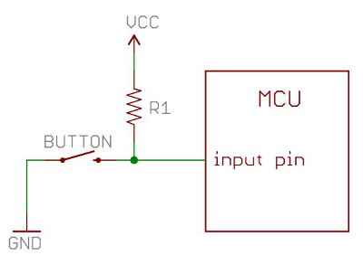
Role of Pull up resistors at the port pins
Let us say you have configured a port pin as input pin.
If there is nothing connected with the pin and your program reads the state of the pin, will it be high of low? It will be difficult to tell.
This state of the pin is referred to as floating state.
In order to prevent this unknown state, pull up resistor is used.
Pull ups are often used with button and switches.
A switch connected at the input pin without pull up resistor
A switch connected at the input pin with pull up resistor

Slide 16
Internal pull up resistor in AVR and its control
In AVR ATmega32 microcontroller, each of the port pins have a pull up resistor having the facility of connecting or disconnecting it with the pin.
The provision of connection or disconnection is controlled by PORTx register. [see the figure]
If we put 1s into bits of PORTx register, the pull up resistors are activated.
Remember that during output of data PORTx is the register in which data has to be written to make it out.

Slide 17
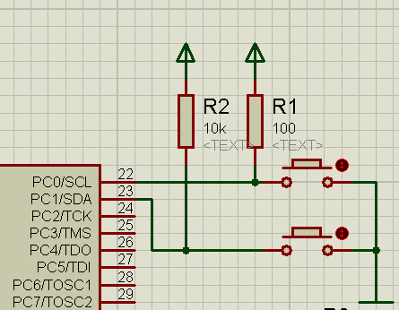
An Example of Input and Output Ports
Two push button switches (Switch 1 and Switch 2) are connected to Pin 0 and 1 of Port C of the ATmega32 chip respectively [A ‘0’ appears at the corresponding pin when a Switch is pressed].

Slide 18
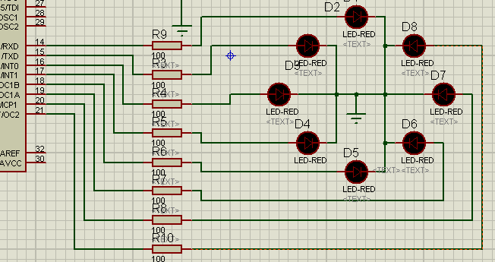
A program on INPUT & OUTPUT
Eight (8) LEDs are connected at Port D and arranged in a circle.
When switch 1 is pressed glowing of one of the LEDs will move in clockwise direction with 0.2 sec interval
And if switch 2 is pressed glowing of LED will move in anti-clockwise direction with 0.2 sec interval.

Slide 19
The Code
while (1)
{
if (push1==0) move=1;
if (push2==0) move=2;
if (move==1) {
output_port=output_port>>1;
if (output_port==0)
output_port=0x80;
}
if (move==2) {
output_port=output_port<<1;
if (output_port==0)
output_port=0x01;
}
delay_ms(200);
}
}
#include <mega32.h>
#include <delay.h>
#define push1 PINC.0
#define push2 PINC.1
#define input_ddr DDRC
#define output_ddr DDRD
#define output_port PORTD
void main(void)
{
char move=0;
input_ddr=0x00;
output_ddr=0xFF;
output_port=0x80;

Slide 20
Keyboard Interfacing
Keyboards and LCDs are the most widely used input/output devices in microcontrollers such as the AVR.
We shall discuss keyboard fundamentals, key pressed and key detection mechanism.
At the lowest level, keyboards are organized in a matrix of rows and columns.
The CPU accesses both the rows and columns through ports.
Therefore, with two 8-bit ports, an 8X8 keyboard can be connected to a microcontroller.

Slide 21
Keyboard in a Matrix
Figure shows 12 key interfaced using one port.
The rows are connected to lower 4 pins of port B and the columns are connected to upper 3 pins of the same port.
If no key has been pressed and rows are read, all rows will be read as ‘1’ since +5V is connected to the rows through internal pull up resistors
PB.0
Row0
PB.1
Row1
PB.2
Row2
PB.3
Row3
PB.4
Colm0
PB5
Colm1
PB.6
Colm2
PB.7
Colm3

Slide 22
How Does It Work?
DDRB
1 | 1 | 1 | 1 | 0 | 0 | 0 | 0
PORTB
1/0 | 1/0 | 1/0 | 1/0 | 1 | 1 | 1 | 1
PINB
 |  |  |  | 1/0 | 1/0 | 1/0 | 1/0
No input
7 6 5 4 3 2 1 0
Inside the microcontroller
+5v
PB.0
Row0
Pull up resistors
PB.1
Row1
PB.2
Row2
PB.3
Row3
PB.4
Colm0
PB5
Colm1
PB.6
Colm2
PB.7
Colm3

Slide 23
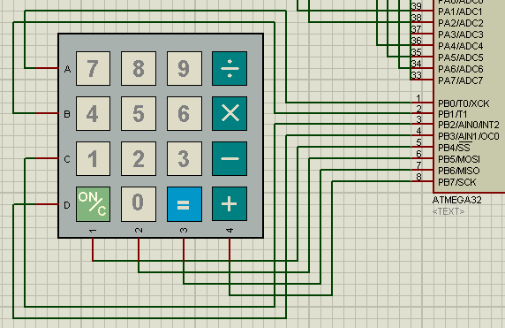
Keypad Interfacing

Slide 24
Row Scanning Technique
First of all, send ‘0’ only in column no 0. [c=0] (i.e. PB.4)
Now if the row lines [PB.0 to PB.3] are read one by one, and if any ‘0’ is read (say) from row ‘r’ [r=0 to 3], it will identify that the switch [in between column no. ‘0’ and the specific row ‘r’] is pressed
If all rows are read as ‘1’, it will correspond to ‘no’ key pressed in that column 0.
Then send ‘0’ to other three columns one after another [column no. c=1 to 3] and similarly the row lines are read, if this process is continuously repeated and if any key is pressed, it will be detected in this process of scanning.

Slide 25
The Code (Part 1)
#include <mega32.h>
#include <alcd.h>
#define keypad_ddr DDRB
#define keypad_port PORTB
#define input_data PINB
void main(void)
{
keypad_ddr=0xF0;
// RS - PORTA Bit 0
// RD - PORTA Bit 1
// EN - PORTA Bit 2
// D4 - PORTA Bit 4
// D5 - PORTA Bit 5
// D6 - PORTA Bit 6
// D7 - PORTA Bit 7
// Characters/line: 16
lcd_init(16);

Slide 26
The Code (Part 2)
while (1)
{
keypad_port=
0b11101111;
lcd_gotoxy(0,0);
if (input_data.0==0)
lcd_putsf(“7");
if (input_data.1==0)
lcd_putsf("4");
if (input_data.2==0)
lcd_putsf(“1");
if (input_data.3==0)
lcd_putsf(“C");
keypad_port=
0b11011111;
lcd_gotoxy(0,0);
if (input_data.0==0)
lcd_putsf(“8");
if (input_data.1==0)
lcd_putsf(“5");
if (input_data.2==0)
lcd_putsf(“2");
if (input_data.3==0)
lcd_putsf(“0");
keypad_port=
0b10111111;
lcd_gotoxy(0,0);
if (input_data.0==0)
lcd_putsf(“9");
if (input_data.1==0)
lcd_putsf(“6");
if (input_data.2==0)
lcd_putsf(“3");
if (input_data.3==0)
lcd_putsf(“=");
keypad_port=
0b01111111;
lcd_gotoxy(0,0);
if (input_data.0==0)
lcd_putsf(“/");
if (input_data.1==0)
lcd_putsf(“*");
if (input_data.2==0)
lcd_putsf(“-");
if (input_data.3==0)
lcd_putsf(“+");
}
}

Slide 27
Thanks

